Slide 1
Software Development Life Cycle models –Cont’d

Slide 2
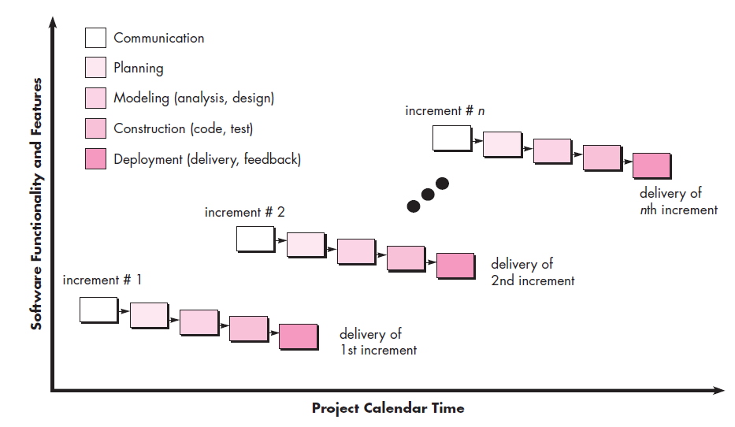
The Incremental Model
The incremental model combines elements of linear and parallel process flows.
Incremental Model is a combination of one or more Waterfall Models.

Slide 3
The Incremental Model
In Incremental Model, Project requirements are divided into multiple modules and each module is developed separately.
During the development of each module, the waterfall model is followed for each module development separately.
Each developed module in the Incremental Model is a standalone feature and could be delivered to the end users to use it.
On an incremental basis other modules are integrated as additional features one after another and finally delivered to the client.

Slide 4
Advantages of Incremental model
Generates working software quickly and early during the software life cycle.
This model is more flexible – less costly to change scope and requirements.
It is easier to test and debug during a smaller iteration.
In this model, customers can respond to each build.
Lowers initial delivery cost.

Slide 5
Disadvantages of Incremental model
Needs good planning and design.
Needs a clear and complete definition of the whole system before it can be broken down and built incrementally.
Total cost is higher than another traditional model..

Slide 6
The Prototyping Model (Evolutionary Model)
The prototyping model is a systems development method in which a prototype is built, tested and reworked as necessary until an acceptable outcome is achieved from which the complete system or product can be developed.
The main purpose of the prototyping model is to satisfy the customer’s needs.
The model presents the working version of the software to the customer at a very early stage.

Slide 7
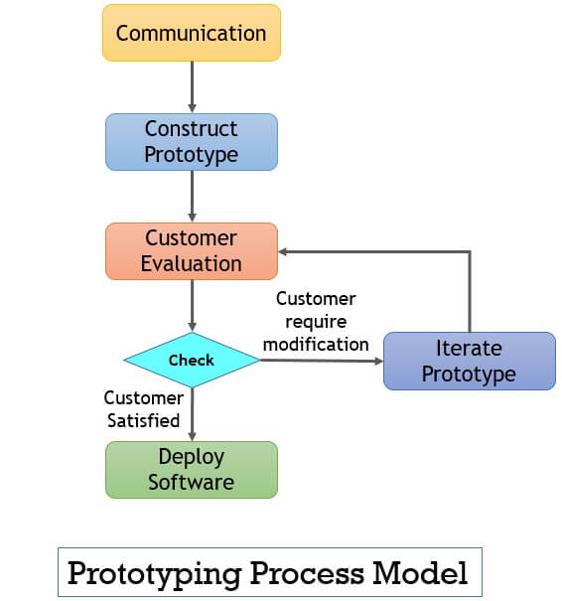
The developers provide the working model to the customer for evaluation. After evaluation customer suggests some modifications if required.
The developer implements these modifications in the prototype.
Then developer demonstrates the modified prototype to the customer for evaluation.
These iterations continue until the customer is completely satisfied with the prototype.
Once the customer is fully satisfied with the prototype, the developer starts implementing the final system.

Slide 8
Types of Prototyping
Throwaway Prototyping
Evolutionary Prototyping
Incremental
Extreme
Throwaway Prototypes are developed from the initial requirements, but they are not used for the final product and are not an alternative to the written requirements specification.
Evolutionary Prototyping is considered the most fundamental form of prototyping, and this prototyping type is also known as breadboard prototyping.
The main concept of this prototyping type is to build a robust prototype and constantly improve it.

Slide 9
Types of Prototyping
Incremental- This technique breaks the concept for the final product into smaller pieces, and prototypes are created for each one. In the end, these prototypes are merged into the final product.
Extreme- This prototype model is used specifically for web development. All web prototypes are built in an HTML format with a services layer and are then integrated into the final product.

Slide 10
When to use the Prototype model
Prototype model should be used when the desired system needs much interaction with the end users.
Typically, online systems, and web interfaces have a very high amount of interaction with end users, and are best suited for the Prototype model.
The Prototype models are excellent for designing good human-computer interface systems.

Slide 11
Advantages of Prototype model
Users are actively involved in the development.
Since in this methodology, a working model of the system is provided, the users get a better understanding of the system being developed.
Errors can be detected much earlier.
Quicker user feedback is available, leading to better solutions.
Missing functionality can be identified easily.
Confusing or difficult functions can be identified. Requirements validation, Quick implementation incomplete but functional, application.

Slide 12
Disadvantages of Prototype model
The main disadvantage of this methodology is that it is more costly in terms of time and money when compared to alternative development methods.
Practically, this methodology may increase the system’s complexity as the scope of the system may expand beyond the original plans.
Incomplete application may cause application not to be used as the full system was designed.

Slide 13
Rapid Application Development (RAD)
It is a type of incremental model.
In RAD model, the components or functions are developed in parallel as if they were mini projects.
The developments are time-boxed, delivered and then assembled into a working prototype.

Slide 14
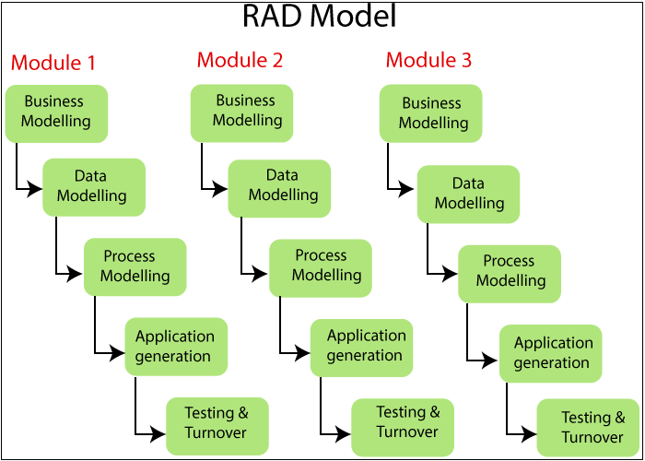
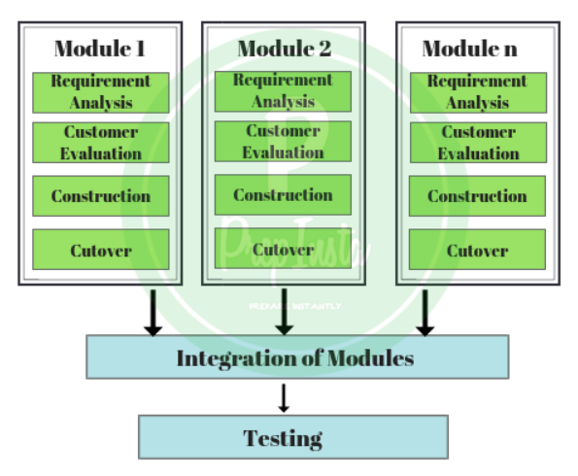

Slide 15
Different Phases of RAD Model
Business Modelling
The information flow is identified between various business functions.
Data Modeling
Information gathered from business modeling is used to define data objects that are needed for the business.
Process Modeling
Data objects defined in data modeling are converted to achieve the business information flow to achieve some specific business objective. Description is identified and created for CRUD(Create, Read, Update, and Delete) of data objects.

Slide 16
Different Phases of RAD Model (Cont’d)
Application Generation:
Automated tools are used to convert process models into code and the actual system.
Testing and Turnover:
Test new components and all the interfaces.

Slide 17
When to use the RAD model
RAD should be used only when a system can be modularized to be delivered in an incremental manner.
It should be used if there is a high availability of designers for Modelling.
It should be used only if the budget permits use of automated code generating tools.

Slide 18
Advantages of RAD Model
RAD model completes the project in a short period of time.
The progress and development of project can be check on various stages.
This model uses the powerful techniques and tools.
reduce cost because very less developers are needed.
Prototype is delivered to the customer so the customer is satisfied.
It has more flexibility and adaptability to acquire the new requirements.
Reusability of the components is increased.

Slide 19
Disadvantages of RAD Model
Only system that can be modularized can be built using RAD.
Requires highly skilled developers/designers.
High dependency on modeling skills.
It can’t be utilized for smaller projects, unfortunately.

Slide 20
The Spiral Model
The spiral model combines an iterative development process and a sequential linear development model.(ie.,it combines Both prototyping and waterfall models).
Spiral model was developed by Barry Boehm in 1986.
The spiral model is a risk-driven process model.
This model is more suitable for complex and expensive projects.

Slide 21
Phases in the Spiral Model
There are four phases in the spiral model.
Planning
Risk Analysis
Development/Test
Evaluation

Slide 22
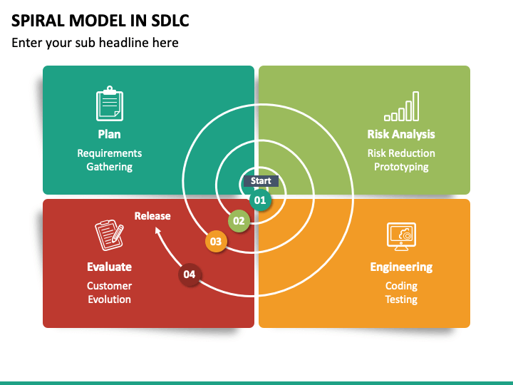

Slide 23
Phases involved in Spiral Model
Planning phase: All the required information about the project will be gathered in this phase. Requirements such as BRS (business requirement specification and SRS (system requirement specifications), design alteration, etc. will be done in this phase. Cost estimation, scheduling the resources for iteration, etc. also happens in this phase.
Risk Analysis: Requirements of the project are studied and brainstorming sessions are conducted to figure out potential risks involved. Once the risk has been identified proper strategies and risk mitigation methodologies will be planned.

Slide 24
Phases involved in Spiral Model
Testing phase: Testing alongside developmental changes will be done in this phase. Coding, test case development, test execution, test summary report, defect report generation, etc. happens in this phase.
Evaluation phase: Customer can evaluate the tests and can give feedback before the project goes to the next level

Slide 25
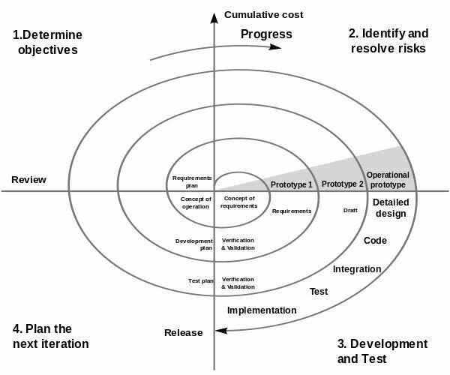

Slide 26
1stiteration :
Activities such as panning, initial risk analysis, engineering evaluation, and requirement gathering happens.
2nd iteration :
Higher level planning, detailed risk analysis, evaluation happens in this phase. 3rd iteration:
Testing-related activities such as coding, tool selection, resource allocation, which test to choose? Etc. Happens in this phase. 4th iteration :
In this customers is the key where they can evaluate the entire process and express their option regarding it.

Slide 27
When to use Spiral Model
A Spiral model in software engineering is used when the project is large.
When releases are required to be frequent, the spiral methodology is used
When the creation of a prototype is applicable.
When risk and costs evaluation is important.
Spiral methodology is useful for medium to high-risk projects.
When requirements are unclear and complex.
When changes may require at any time.
When long term project commitment is not feasible due to changes in economic priorities.

Slide 28
Advantages of Spiral Model
Additional functionality or changes can be done at a later stage.
Cost estimation becomes easy as the prototype building is done in small fragments.
Continuous or repeated development helps in risk management.
Development is fast and features are added systematically in Spiral development.
There is always a space for customer feedback.

Slide 29
Disadvantages of Spiral Model
Spiral development works best for large projects only also demands risk assessment expertise.
For its smooth operation spiral model protocol needs to be followed strictly.
Documentation is more as it has intermediate phases.
Risk of not meeting the schedule or budget.
Spiral software development is not advisable for a smaller project, it might cost them a lot.

